Slide 1


Cross-linguistic word-medial stop lenition: A Functional PCA approach
Seung Suk (Josh) Lee, Morgan Sonderegger, and Meghan Clayards
McGill University
6/27/2026
LabPhon20 in Montréal

Slide 2
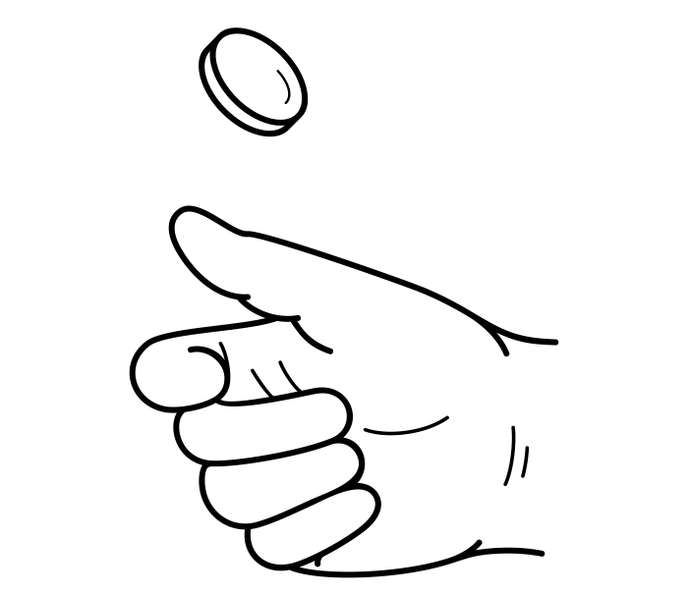
Prosodic position affects acoustic realization of stop consonants
Professor Cho’s Talk on Thursday
Domain-initial strengthening
Segments are produced with stronger articulation at the beginning of a larger prosodic domain.
e.g., English: Oller 1973; Fougeron & Keating 1997; French, Korean, Taiwanese: Keating et al. 2003; German: Kuzla et al. 2007; Italian: Farnetani & Varya 1996; Tagliapietra & McQueen 2010; Japanese: Onaka 2003
Domain-medial continuity lenition
Segments are produced with weaker articulation at the middle of a prosodic domain
e.g., Campidanese Sardinian: Katz and Pitzanti 2019; Ecuadorian and Peruvian Spanish: Kingston 2008; Gran Canaria Spanish: Broś et al. 2021; Seoul Korean: Jun 1993; Han 2000; Cho and Keating 2001; SS Lee 2025
[CVCV]
_{PWd}

Slide 3
Variation in acoustic correlates of Domain-initial strengthening
Phrase/Word-initial consonants are
Usually longer^{1,2}
Not always longer (French², Taiwanese², Spanish^{3,4})
Sometimes even shorter
(Dutch voiceless stops⁵, English /n/⁶, Seoul Korean /n/⁷ and fortis stops⁸)
Variation
Cross-linguistic variation
Stop-type variation (nasal, voiced/voiceless oral stops)
1 Fougeron and Keating 1997
2 Keating et al. 2004
3 Hualde et al. 2011
4 Torreira and Ernestus 2011
5 Cho and McQueen 2005
6 Cho et al. 2017
7 Jang et al. 2018
8 Yun 2022
Notes:
streamline the transition from intro to initial strengthening / lenition

Slide 4
Flip side of Domain-initial strengthening: Domain-medial continuity lenition
Katz 2016
Lenition can be a prosodic segmentation cue
Lenition “conveys to the listener that the current constituent is continuing rather than ending or a new one beginning.” Kingston 2008

Slide 5
Variation in acoustic correlates of Word-medial continuity lenition
Shorter duration
Shallower intensity transition from preceding V
increased “sonority”
Variation?
Cross-linguistic variation?
Stop-type variation (nasal, voiced/voiceless oral stops)?
Lavoie 2001
Gurevich 2011
Szigetvári 2008
Kingston 2008
Ennever et al 2017
Katz 2016
Katz and Pitzanti 2019
Broś et al. 2021
SS Lee 2025

Slide 6
Word-medial lenis stop lenition from Seoul Korean
SS Lee 2025
Word-initial /a # ka/
Word-medial /a . k a/
43 ms
70 ms
Voicing¹
&
Shorter duration²
Tokens from Seoul Corpus Yun et al. 2015
1 Jun 1993, 1998
2 Cho and Keating 2001

Slide 7
V.CV has a shallower + smaller intensity transition compared to V#CV
SS Lee 2025

Slide 8
Research questions
Across languages, how consistent is the word-medial continuity lenition in two acoustic correlates of lenition,
i.e., duration & intensity?
How consistent is it across stop types (voiceless/voiced oral stops, nasal stops)?

Slide 9
This study: FPCA to operationalize the degree of lenition in terms of intensity
Methods used in previous studies^{1,2,3,4} varied across languages and were optimized for language-specific analyses, rather than cross-linguistic comparison
Functional Principal Component Analysis (Ramsey and Silverman 2005)
Dimensionality reduction technique, captures major patterns of variation in contour shape
Data-driven: no a priori assumptions about how the intensity contours would vary
1. Kingston 2008
2. Ennever et al 2017
3. Katz and Pitzanti 2019
4. SS Lee 2025

Slide 10
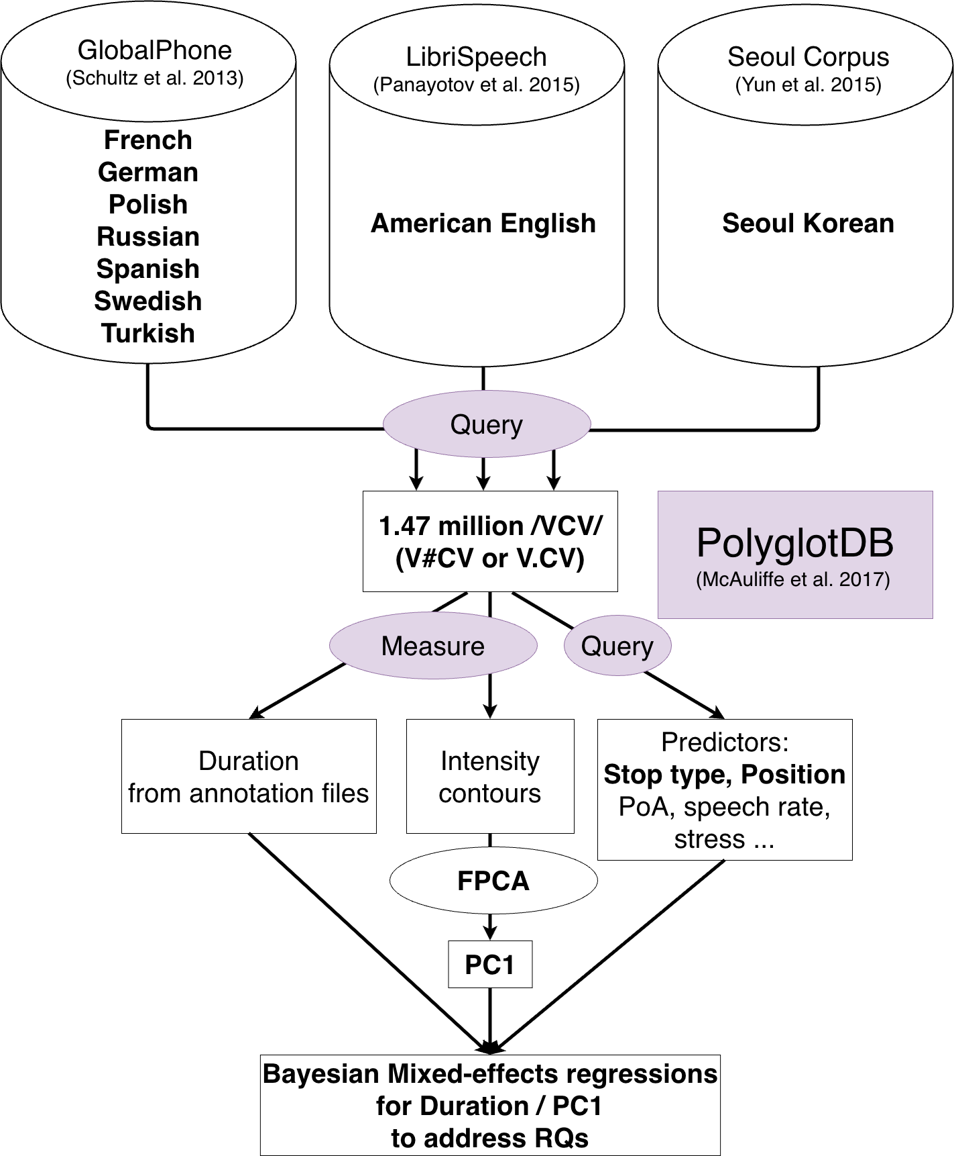
Research pipeline

Slide 11
Data: 9 languages from 3 corpora French (American) English German (Seoul) Korean Polish Russian Spanish Swedish Turkish

Slide 12
Query using PolyglotDB¹ 1.47 million /VCV/ sequences (V#CV or V.CV) across 9 languages
McAuliffe et al. 2017

Slide 13
Measure Duration & Intensity + code other predictors using PolyglotDB¹
McAuliffe et al. 2017

Slide 14
FPCA on /VCV/ intensity contours pooled across 9 languages

Slide 15
Statistical modeling to address RQs
A nice CSV file for
each language!
McAuliffe et al. 2017

Slide 16
FPCA results

Slide 17
FPCA results: PC1
40% of the variation
V C V
Low PC1:
Small and shallow
(or more “flat”)
intensity transition
High PC1:
Large and steep
intensity transition

Slide 18
PC1 distinguishes stop type Nasal < Voiced < Voiceless
Voiced
(Lenis)
Voiceless
(Fortis/Aspirated)
PC1 captures
the degree of “dip”
(which seems to be a correlate of “sonority” among stops)
Nasal

Slide 19
Statistical modeling
RQs
Across languages, do word-medial stops have shorter duration and/or have a “more flat” intensity transition (PC1) than word-initial ones?
How consistent is it across stop types?
voiceless/voiced oral stops, nasal stops
Two Bayesian mixed-effects linear regressions per language
PC1/duration ~ Word position * Stop type
+ controls (e.g., speech rate, place of articulation, word stress … )
+ random effects
More on word stress later
QnA: other effects

Slide 20
Estimated marginal median differences in Duration (X-axis) and PC1 (Y-axis) between Word-medial and Word-initial positions
0
Word-medial intensity-flattening
Word-medial shortening
0

Slide 21
BLACK in the third quadrant if there’s word-medial lenition (duration & intensity)
😟
😆
Word-medial intensity-flattening
Word-medial shortening
Notes:
95% highest posterior density intervals

Slide 22
Word-medial nasal stops: lenited in terms of duration and intensity Except Spanish, Swedish, French
Notes:
95% highest posterior density intervals

Slide 23
Word-medial voiced (Lenis) stops: most consistently lenited in terms of duration and intensity Except Spanish
Lenis

Slide 24
Word-medial voiceless (Aspirated/Fortis) stops: language-specific, mostly lenited in terms of intensity Except Spanish, Korean, Swedish + (French, Russian no difference in duration)
Aspirated
Fortis

Slide 25
Word-medial lenition is mostly consistent across languages & stop types

Slide 26
Summary
We examined word-medial lenition across nine languages in large force-aligned corpora
We quantified lenition using an FPCA-based measure of intensity
We found a near universal tendency for word-medial stops to be weaker than word-initial ones in duration and/or intensity transition
QnA: Exceptions do exist but are attributable to language-specific phonology
Word-medial voiced stops were the most consistently lenited in both duration and intensity transition across languages

Slide 27
Supplementary analysis: word stress
Stronger articulation in stressed syllables (e.g., Bouavichith and Davidson 2013)
Word stress is confounded with word position in many languages
Refit models for English, German, Russian, Spanish, and Swedish (lexical pitch accent) with word stress included as a predictor in each model
Word stress does not exist in Seoul Korean, or was not available in the pronunciation dictionaries in the corpora we used
If the apparent word-position effects are driven by word stress rather than position itself, then controlling for word stress in the model should substantially reduce or eliminate the word-position effects

Slide 28
Including stress (X → O) in the model does not make the effects of word position completely disappear
Exception

Slide 29
Word stress
Including word stress did not make the word position effects disappear completely, though it affected the size of the word position effects
In languages like English or German, main stress is usually at the beginning of the word
Listeners hearing a strongly pronounced stop in these languages receive a convergent cue, to both word onset and stress

Slide 30
Conclusion
Continuity lenition is a plausible cross-linguistic cue to prosodic segmentation
Language specific patterns suggest speakers must learn continuity lenition for their own language
Future work will expand to more languages
and investigate lenition patterns in each language in more detail

Slide 31
Acknowledgments
This work was supported by Canada Research Chair #CRC-2023-00009 and NSERC grant #RGPIN-2023-04873 to Morgan Sonderegger, and SSHRC grant #435-2024-0996 to Meghan Clayards
Many thanks to members of MCQLL at McGill for their valuable feedback. All errors remain our own.

Slide 32
Thank you!
If you’re interested, please read our paper which will appear in Interspeech 2026 (September in Sydney, Australia),
and check out our OSF repository doi.org/10.17605/OSF.IO/CE65H

Slide 33
References
Bouavichith, D., & Davidson, L. (2013). Segmental and Prosodic Effects on Intervocalic Voiced Stop Reduction in Connected Speech. Phonetica, 70(3), 182–206. https://doi.org/10.1159/000355635
Broś, K., Żygis, M., Sikorski, A., & Wołłejko, J. (2021). Phonological contrasts and gradient effects in ongoing lenition in the Spanish of Gran Canaria. Phonology, 38(1), 1–40. https://doi.org/10.1017/S0952675721000038
Cho, T., Kim, D., & Kim, S. (2017). Prosodically-conditioned fine-tuning of coarticulatory vowel nasalization in English. Journal of Phonetics, 64, 71–89. https://doi.org/10.1016/j.wocn.2016.12.003
Cho, T., & McQueen, J. M. (2005). Prosodic influences on consonant production in Dutch: Effects of prosodic boundaries, phrasal accent and lexical stress. Journal of Phonetics, 33(2), 121–157. https://doi.org/10.1016/j.wocn.2005.01.001
Cohen Priva, U., & Gleason, E. (2020). The causal structure of lenition: A case for the causal precedence of durational shortening. Language, 96(2), 413–448. https://doi.org/10.1353/lan.2020.0025
Ennever, T., Meakins, F., & Round, E. R. (2017). A replicable acoustic measure of lenition and the nature of variability in Gurindji stops. Laboratory Phonology: Journal of the Association for Laboratory Phonology, 8(1), 20. https://doi.org/10.5334/labphon.18
Hualde, J. I., Simonet, M., & Nadeu, M. (2011). Consonant lenition and phonological recategorization. Laboratory Phonology, 2(2). https://doi.org/10.1515/labphon.2011.011
Jang, J., Kim, S., & Cho, T. (2018). Focus and boundary effects on coarticulatory vowel nasalization in Korean with implications for cross-linguistic similarities and differences. The Journal of the Acoustical Society of America, 144(1), EL33–EL39. https://doi.org/10.1121/1.5044641
Katz, J., & Pitzanti, G. (2019). The phonetics and phonology of lenition: A Campidanese Sardinian case study. Laboratory Phonology: Journal of the Association for Laboratory Phonology, 10(1), 16. https://doi.org/10.5334/labphon.184
Keating, P., Cho, T., Fougeron, C., & Hsu, C.-S. (2004). Domain-initial articulatory strengthening in four languages. In J. Local, R. Ogden, & R. Temple (Eds.), Laboratory Phonology VI: Phonetic interpretation (pp. 143–161). Cambridge University Press.
Kingston, J. (2008). Lenition. Selected Proceedings of the 3rd Conference on Laboratory Approaches to Spanish Phonology.
Lee, S. S. (2025). Simultaneous encoding and decoding of laryngeal contrasts and prosodic structure in Seoul Korean [Doctoral]. University of Massachusetts Amherst.
McAuliffe, M., Stengel-Eskin, E., Socolof, M., & Sonderegger, M. (2017). Polyglot and Speech Corpus Tools: A System for Representing, Integrating, and Querying Speech Corpora. Interspeech 2017, 3887–3891. https://doi.org/10.21437/Interspeech.2017-1390
Panayotov, V., Chen, G., Povey, D., & Khudanpur, S. (2015). Librispeech: An ASR corpus based on public domain audio books. 2015 IEEE International Conference on Acoustics, Speech and Signal Processing (ICASSP), 5206–5210. https://doi.org/10.1109/ICASSP.2015.7178964
Ramsay, J. O., & Silverman, B. W. (2005). Functional data analysis (2. ed., [Nachdr.]). Springer.
Schultz, T., Vu, N. T., & Schlippe, T. (2013). GlobalPhone: A multilingual text & speech database in 20 languages. 2013 IEEE International Conference on Acoustics, Speech and Signal Processing, 8126–8130. https://doi.org/10.1109/ICASSP.2013.6639248
Yun, W., Yoon, K., Park, S., Lee, J., Cho, S., Kang, D., Byun, K., Hahn, H., & Kim, J. (2015). The Korean Corpus of Spontaneous Speech. Phonetics and Speech Sciences, 7(2), 103–109. https://doi.org/10.13064/KSSS.2015.7.2.103
Yun, Y. (2022). Closure durations of Korean stops at three positions. Phonetics and Speech Sciences, 14(4), 11–17. https://doi.org/10.13064/KSSS.2022.14.4.011

Slide 34
EXTRA SLIDES

Slide 35
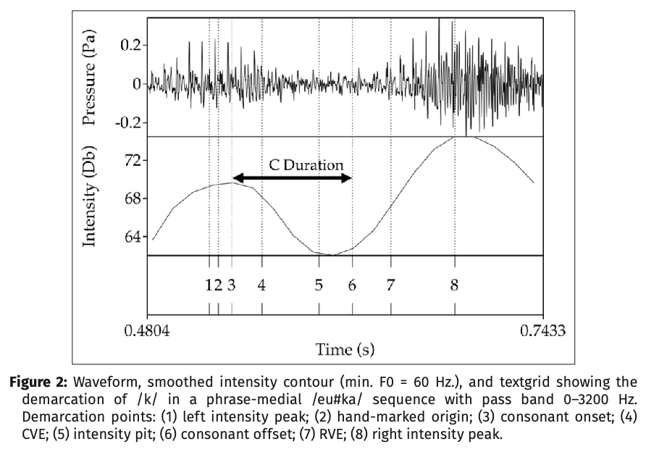
Katz and Pitzanti 2019:13

Slide 36
Exceptions
Spanish voiced/voiceless stops showed no (or very small) difference in duration
Consistent with previous studies (Hualde et al 2011, Torreira and Ernestus 2011)
Korean word-medial fortis stops were longer and less lenited (new!)
Consistent with the previously reported pattern (e.g., Yun 2022)
Korean word-medial aspirated stops were less lenited and not shorter
Previous studies report shorter VOT word-medially (Cho and Jun 2000)
PC1 results possibly due to vowel devoicing after word-initial stops?
Devoiced vowels are lower in intensity, making the transition from the stop to the following vowel more continuous, and therefore lower in our PC1
Future work should investigate this issue further
Swedish word-medial nasal and voiceless stops were less lenited or longer
Geminates were transcribed as singletons in the pronunciation dictionary of GlobalPhone
Geminates only occur word-medially
Future work should correct for this issue

Slide 37
Big effects size for Korean
Spontaneous speech vs. read speech
To be confirmed in the future with read-speech data
Seoul Korean stop acoustics may be more prosody-dependent than other languages
e.g., Domain-initial denasalization, which will make word-initial lenis less lenited in terms of intensity

Slide 38
Other results
fPC1/duration ~ Word position * Stop type
+ Speech rate
+ Place of articulation
+ Neighboring vowel height
+ Syllable predictability
+ (Syllable stress)
+ by-speaker
+ by-word (indexed with syllable position, e.g., /p₁at₂a/)
+ by VCV sequence (e.g., pata)
Random intercepts
Random slopes for predictors of interest: word position and stop type

Slide 39
Unstressed syllable onsets are more lenited than stressed syllable onsets in both duration and intensity

Slide 40
Speech rate: faster, more lenited (duration)

Slide 41
Speech rate: faster, more lenited (PC1)

Slide 42
PoA: velar longer, but more lenited in PC1?

Slide 43
Preceding vowel height: low more lenited than non-low? (Kirchner 1998, cf. Kingston 2008)

Slide 44
Following vowel height: low more lenited than non-low? (Kirchner 1998, cf. Kingston 2008)

Slide 45
Possible limitations
“Word” defined morphosyntactically (white-space delimited sequence of graphemes), may not align perfectly well with “Prosodic word”
Potential cross-linguistic variation in the force-alignment accuracy
Duration for heavily lenited segments may not be accurate
Some of these tokens may have been deleted
They might have been included only because the pronunciation dictionary did not not contain a pronunciation variant with deletion.

